Slide 1
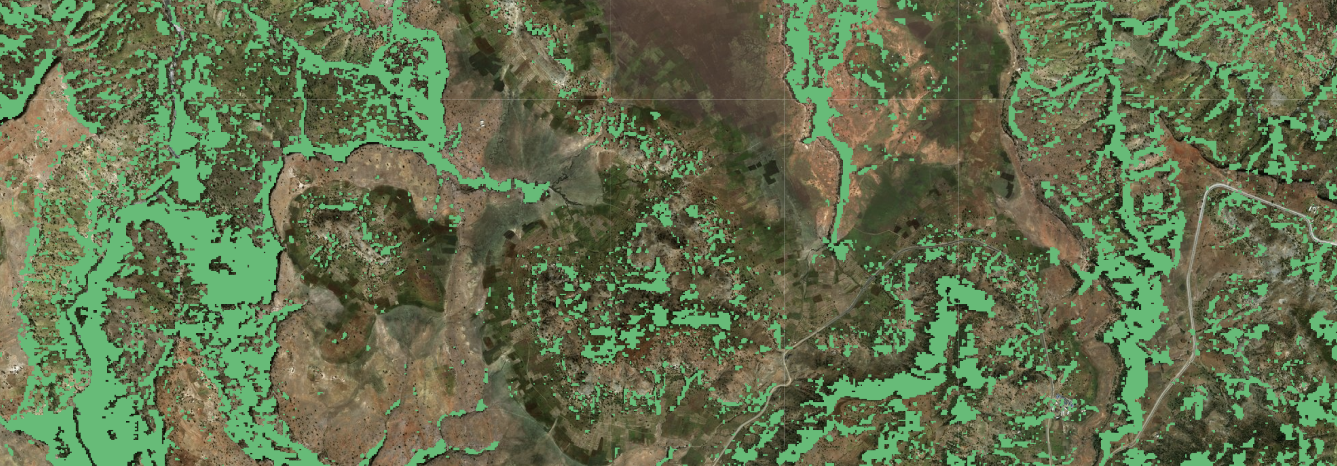
Monitoring trees outside the forest
John Brandt
World resources institute

Slide 2
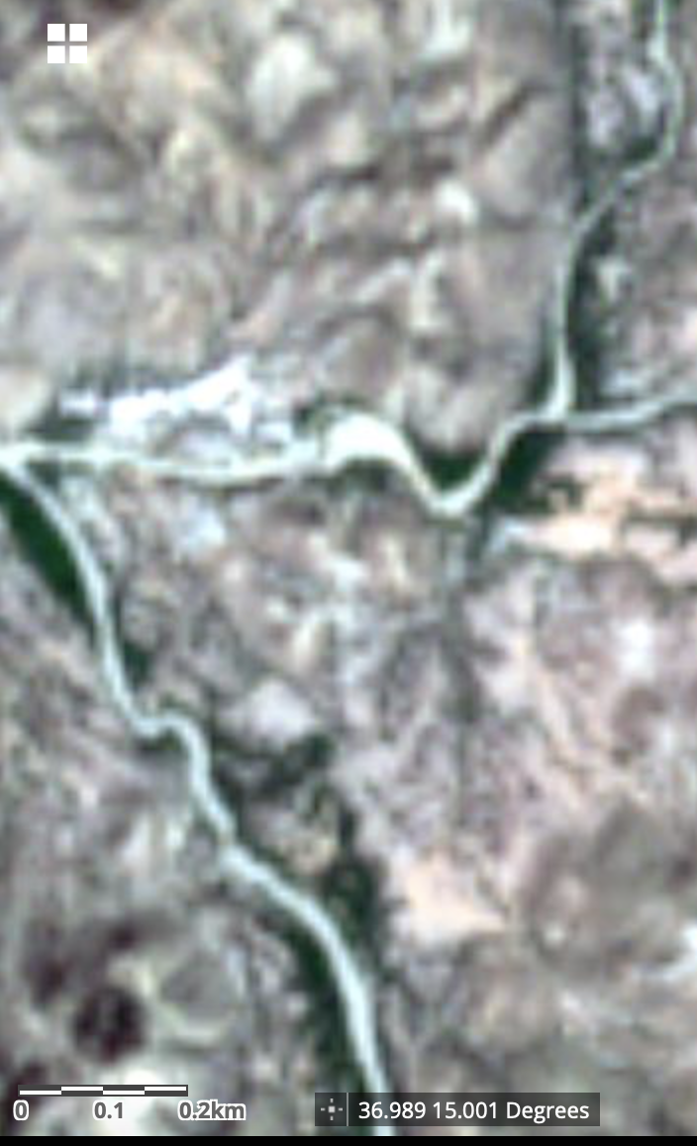
Issues in monitoring trees outside forest
Low resolution of imagery
High background variability and noise
Small object size
Sub 10m shifts in georeferencing
Hill shade and terrain
Traditional ML approaches on GEE are not expressive enough (RF)
Out of box computer vision approaches do not work because of small image size, variability of data, and variability of segmentation maps

Slide 3
Going out of the forests
While current forest monitoring data is great at forest monitoring, it is not tailored to monitoring restoration outside the forest
False positives in grasslands and crops
False negatives in mosaic landscapes
Wall-to-wall restoration monitoring must prioritize accuracy on heterogenous landscapes, rather than homogenous landscapes
Proposing complimentary data to monitor trees outside the forest

Slide 4
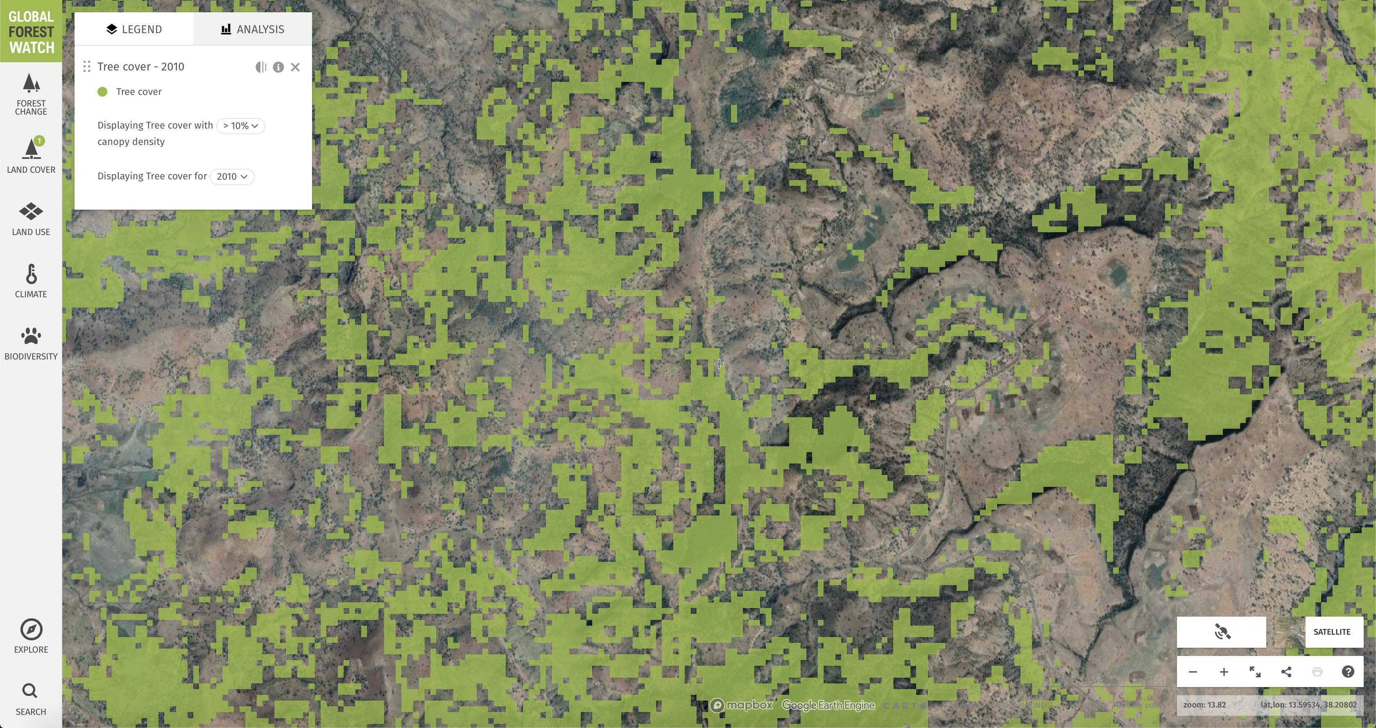
Scattered trees have variable backgrounds
Trees look like crops
Trees look like grass

Slide 5
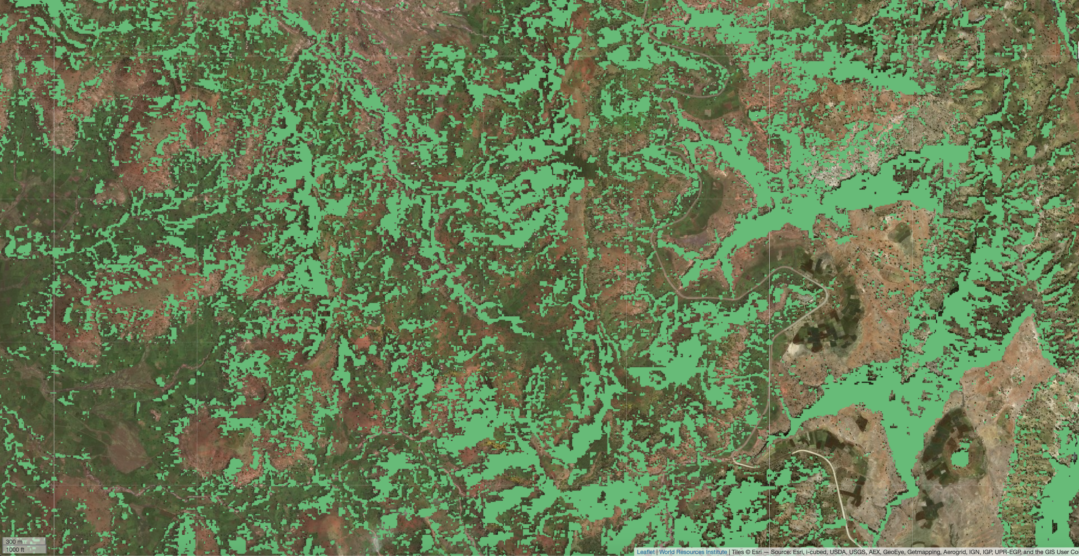

Slide 6
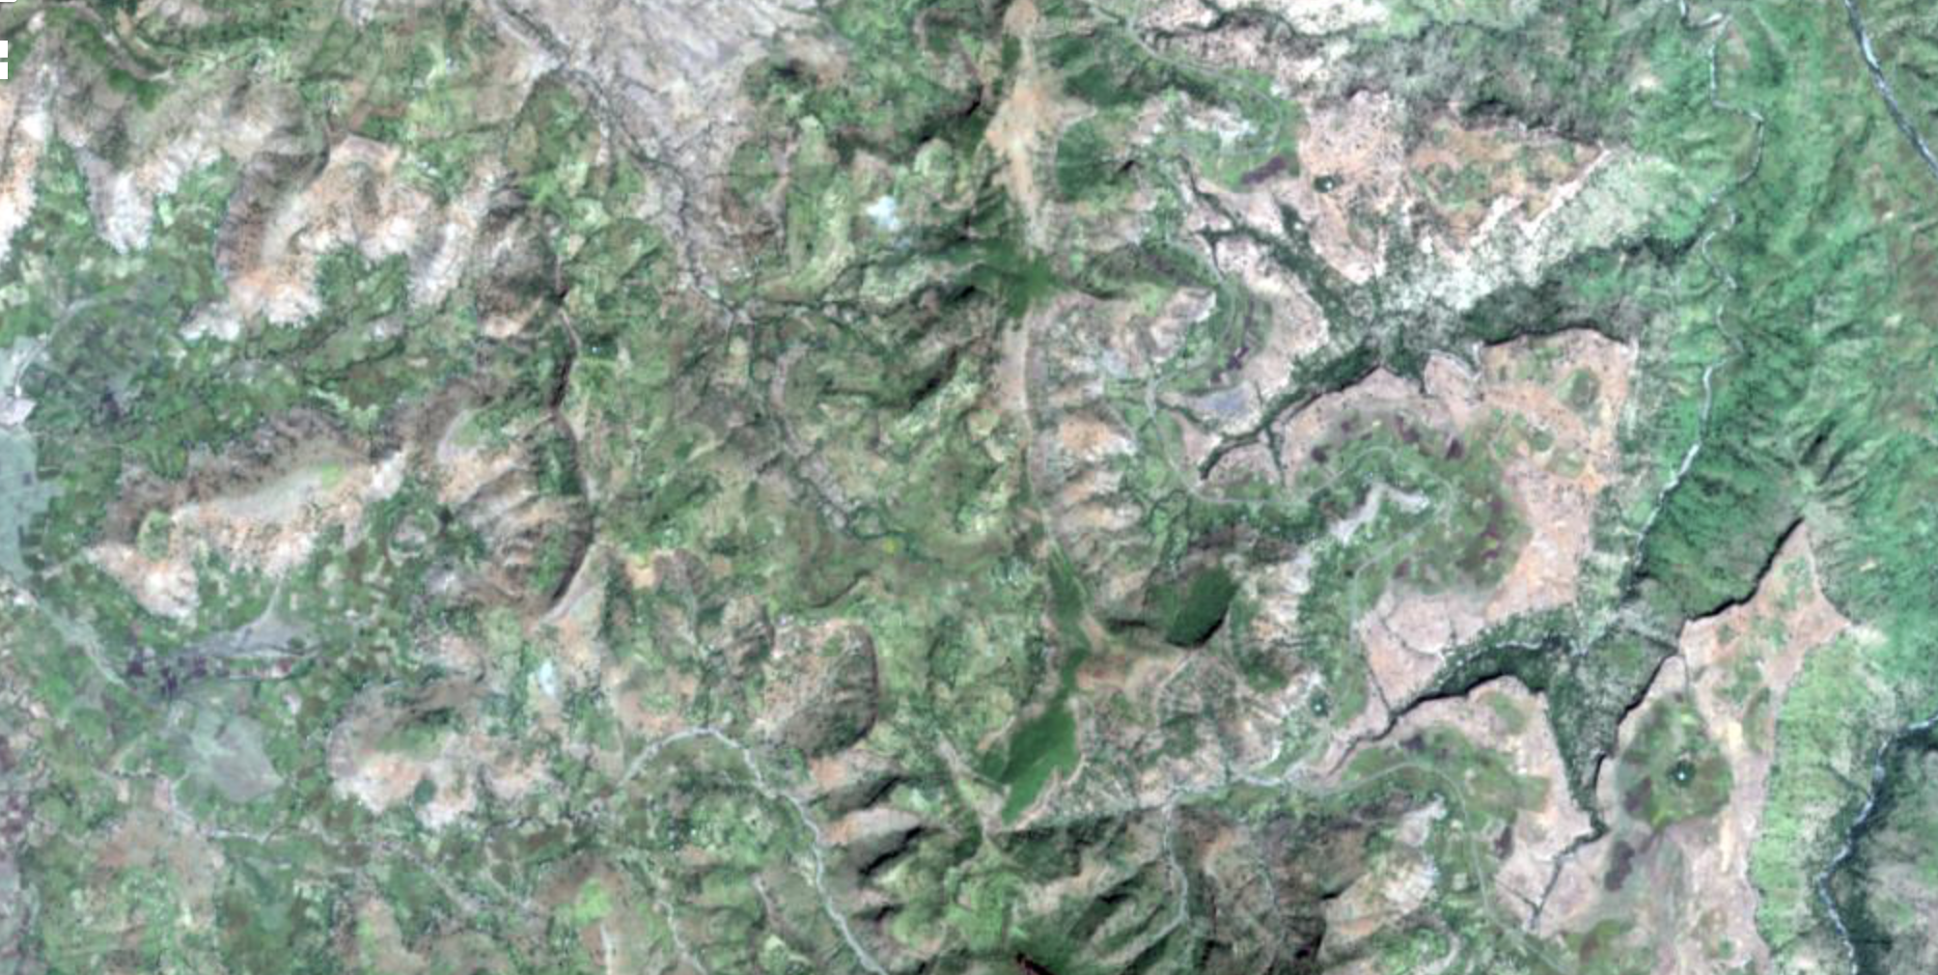

Slide 7
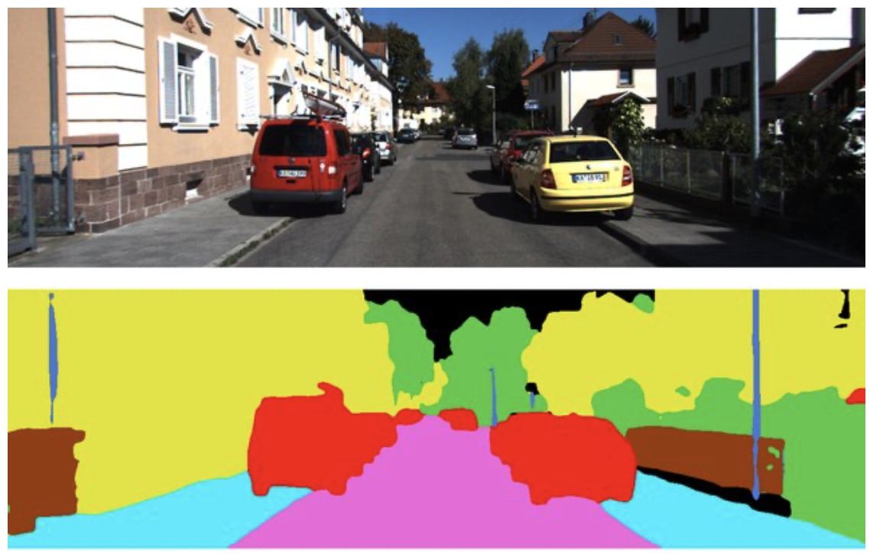
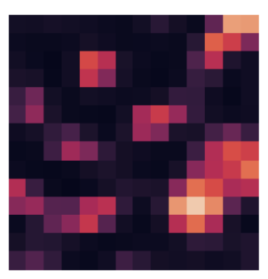
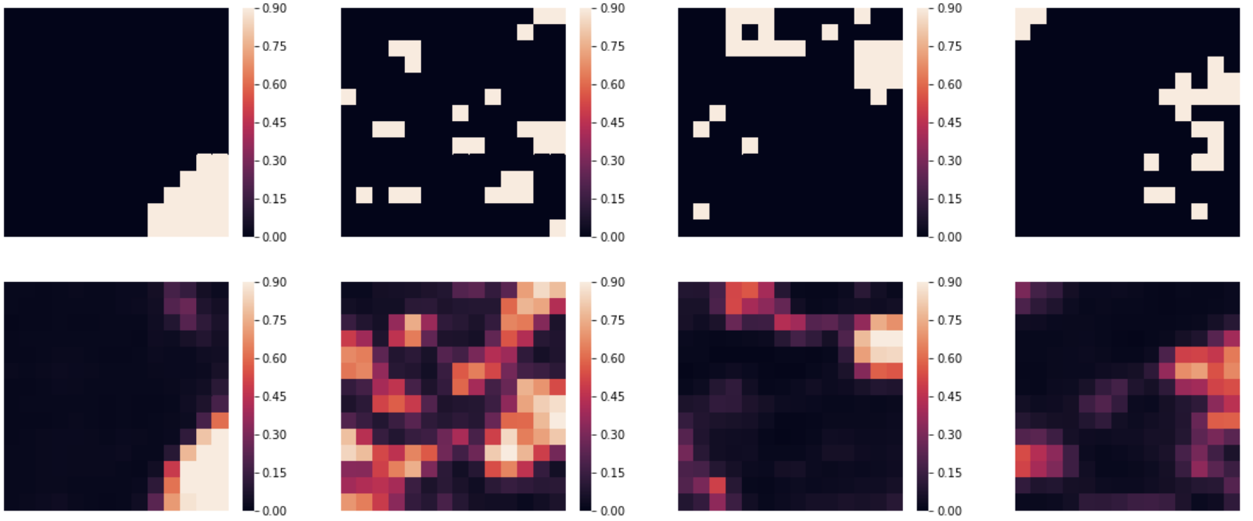
Why out-of-box algorithms fail
1 million + pixels
Shapes consistent
Regions consistent
Colors consistent
196 pixels
No shape, region, or color consistency
Each output is distinct

Slide 8
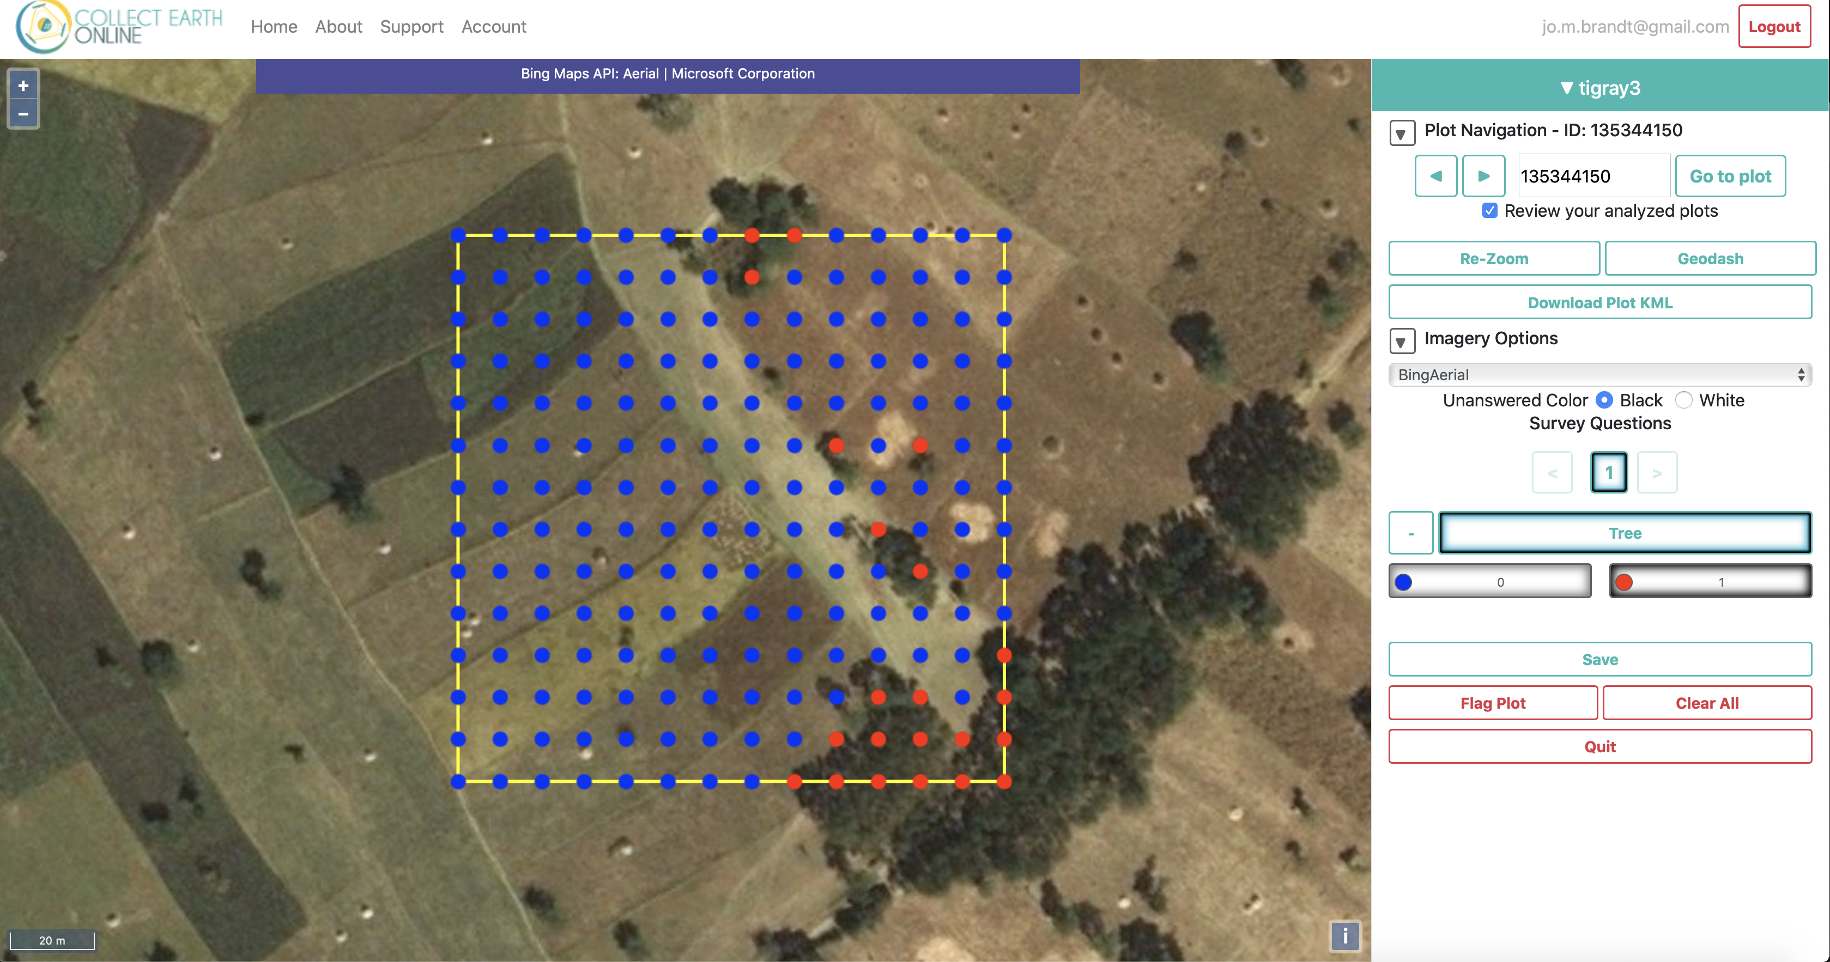
DATA
700 2 hectare plots
Randomly sampled across Tigray, Ethiopia

Slide 9
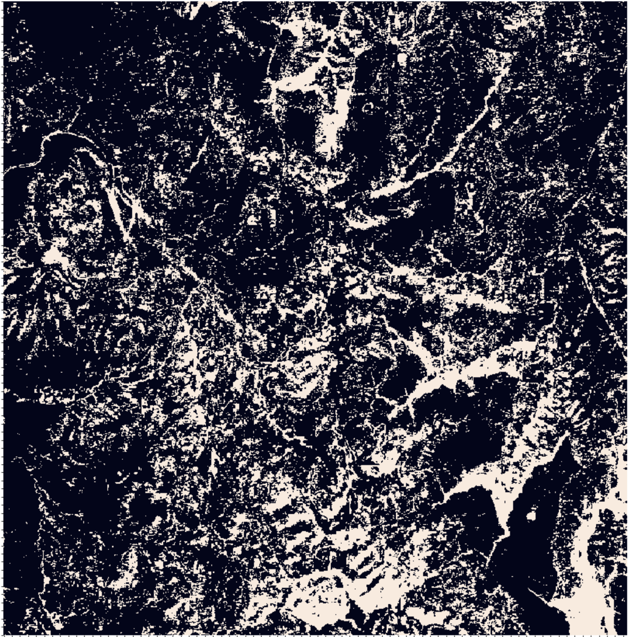
Quick DEMO
Link

Slide 10
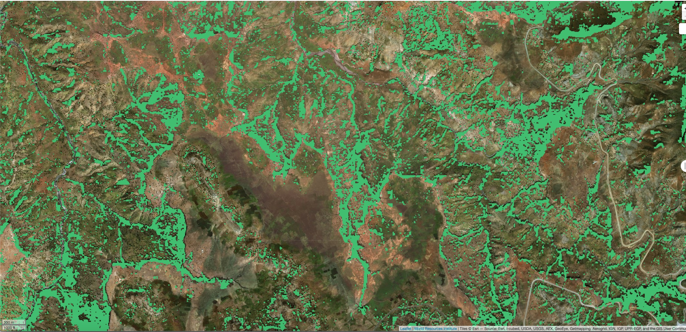

Slide 11
Methods - Preprocessing
Data selection
Biweekly mean composites of 10 and 20m bands
2 images / month with lowest cloud cover, capped at 20%
Bilinearly interpolate missing imagery
Normalize data to [0, 1] range
Fuse slope calculated from DEM to S2
Georeference correction
Expectation maximization

Slide 12
Methods - Modeling
Fully convolutional network with:
Convolutional LSTM encoder with layer normalization and zone out
Feature pyramid attention between encoder and decoder with DropBlock
Concurrent spatial and channel squeeze excitation decoder
AdaBound optimizer
Focal loss for a warm-up, fine tuned with Lovasz softmax. Focal loss is tuned (gamma and alpha) for each image.
Equibatch sampling, visiting every C clusters each N samples

Slide 13
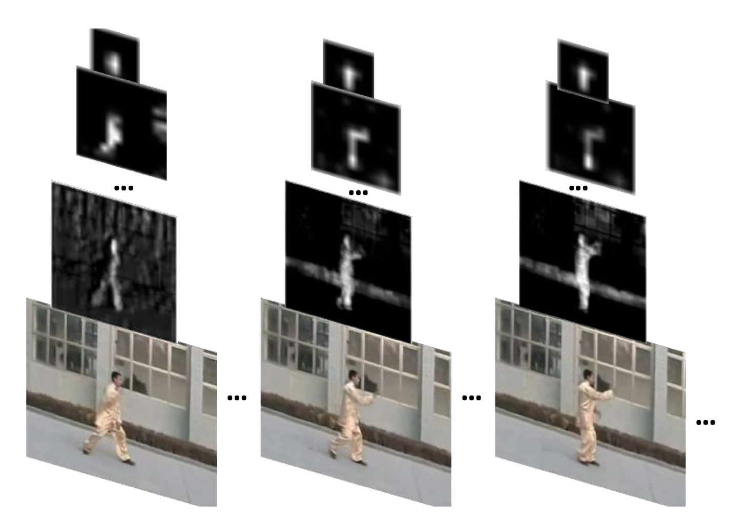
Modeling Spatiotemporal relationships
Generate 24 different “feature maps” that represent how 30x30m grids of the plot change over the year
Weight the 24 different feature maps by how relevant they are to disambiguating trees from background
Convolutional LSTMs allow for the representation of temporal and temporal relationships concurrently

Slide 14
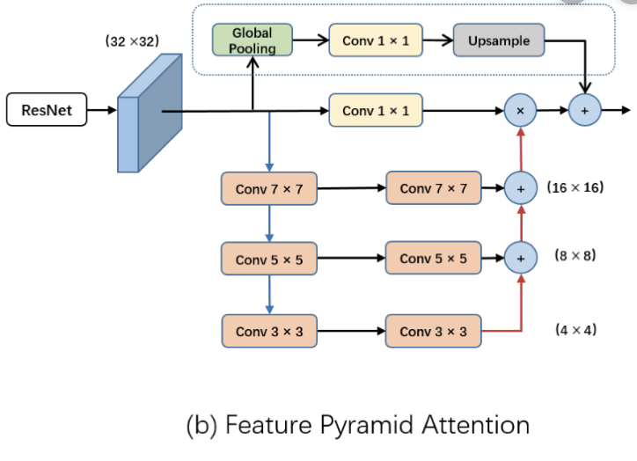
Incorporating long-distance context
To optimize single pixel accuracy while modeling long distance relationships:
Feature pyramid attention (+4%)
Adabound optimizer (+3%)
Hypercolumn decoder (+2%)
cSSE blocks (+1%)

Slide 15
Sampling methods, Regularization
Stratified sampling
Equibatch (+5%)
Layer norm, batch re-norm (+1%)
L2 loss (+0.5%)
Zone out (+3%)
Data augmentation (+3%)
Heavy gradient clipping

Slide 16
Metrics
Prediction speed: 312,000 ha/hour/core
Model parameter size: 90,000 (vs. 60M-130M+ in out of box algorithms) – 600-1400x faster
Map of Ethiopia, 16 core VM / K80 GPU @ $0.48 / hour (above fixed cost of data IO)
This approach: 20 hours / $9
DeepLab V3: 36 months / $12,441
PSPNet: 13 months / $4,416
Suggests ability to detect 2% tree cover difference at 2 ha scale outside of forests
Tree cover % | Precision @ 10 m | Recall @ 10 m | Percent error @ 2 ha
50+ | 90% | 88% | 2%
20-50 | 68% | 70% | 2%
<20 | 45% | 68% | 2%
Overall | 65% | 72% | 1.60%

Slide 17
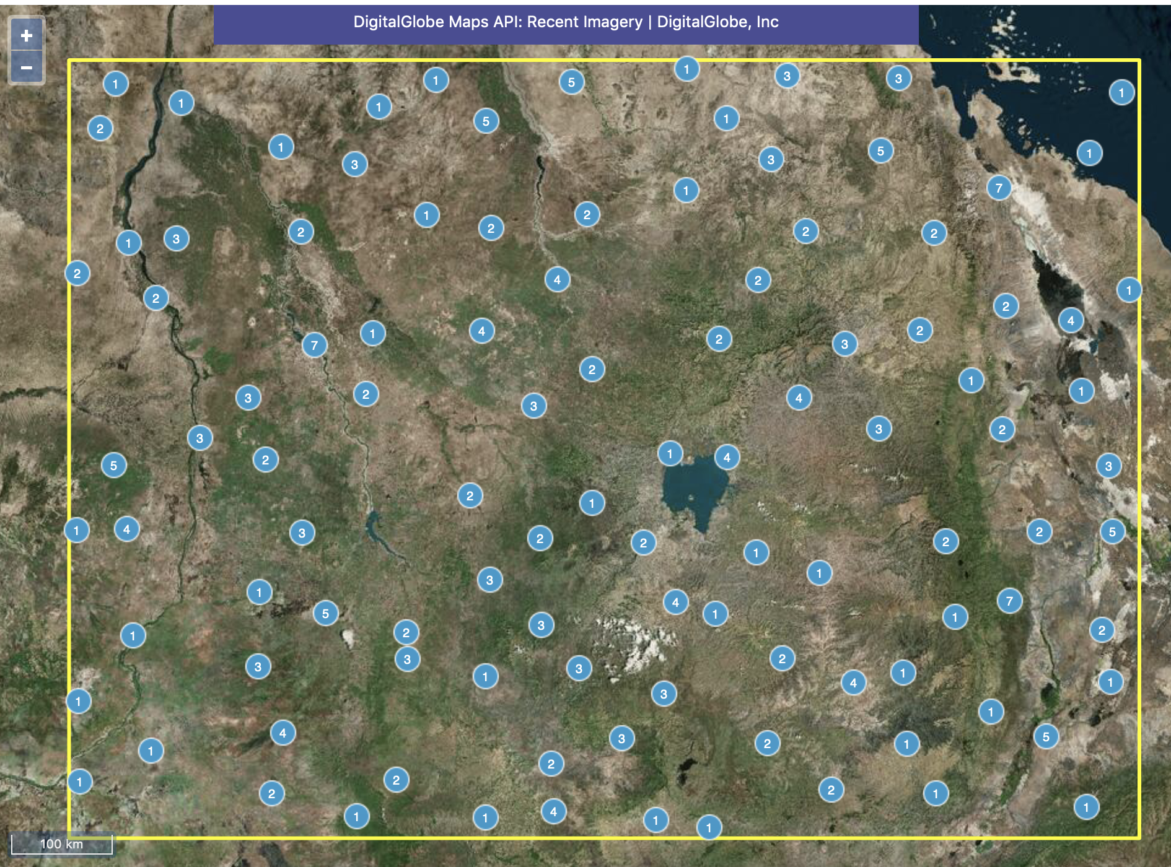
Test plots
200 2 ha plots across 8 million km² in
Ethiopia
Sudan
South Sudan
Djibouti
Somalia

Slide 18
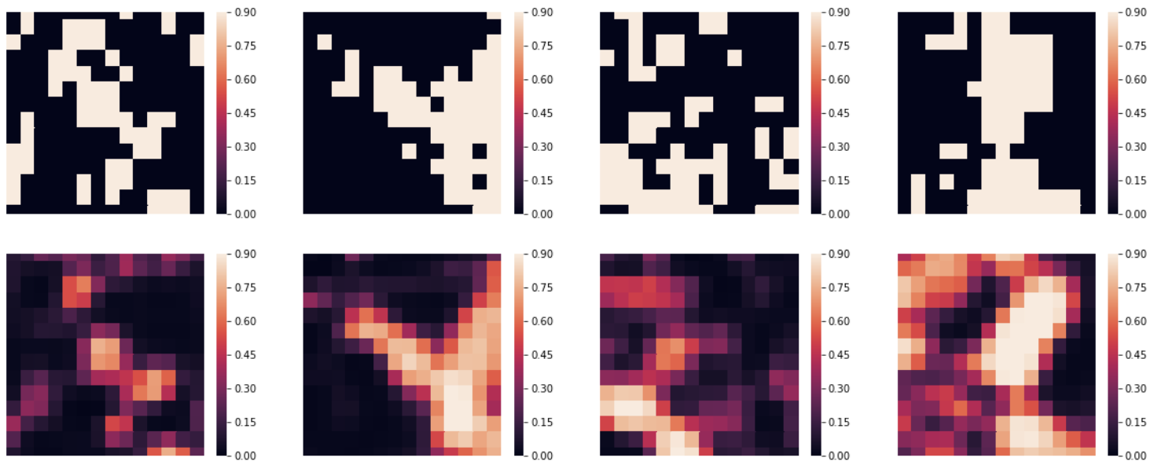
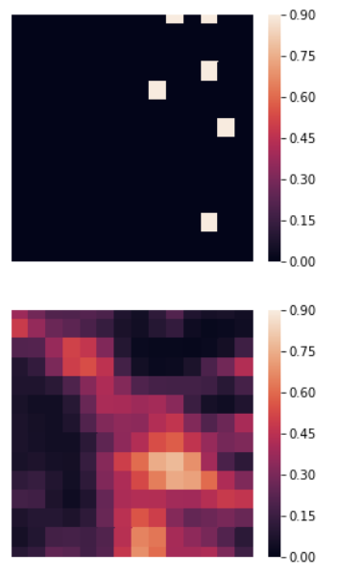
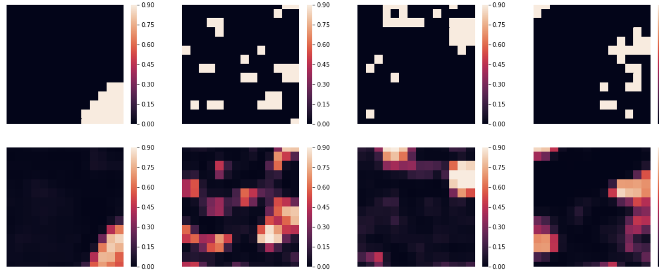
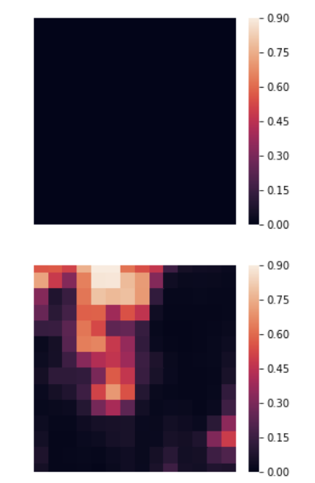
Success cases failures

Slide 19
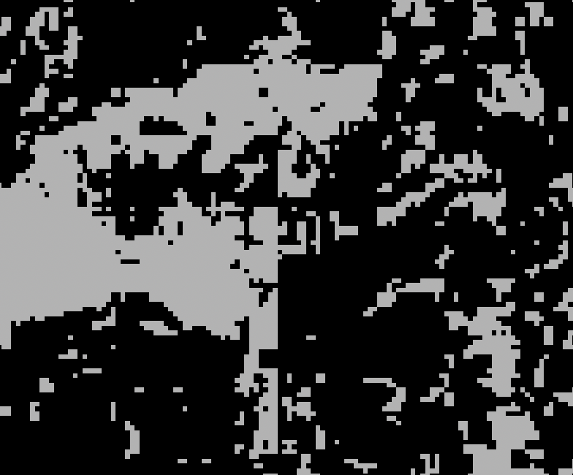
Future research directions - methods
S1 S2 fusion
Atruous convolutions
Better data augmentation
Hyperparameter search
Regularization search
Self training
Stratified K-fold training and ensembling
Temporal squeeze and excitation
Post processing – smoothing and conditional random fields

Slide 20
Future research directions - applications
Short term: 50,000 hectare -> 500,000 hectare maps (regional)
Medium term: Multi-year imagery and tree cover change
Long term: Other biomes and geographic regions

Slide 21
Conclusions and questions
Complimentary research product to existing forest monitoring data and methodologies, focusing on trees outside the forest by using artificial intelligence to focus attention on disambiguating trees from crops and grassland with a methodology that is computationally scalable to global levels
Still in research stage but performs well on 30-50,000 ha mosaic landscapes with only 1,000 ha of labeled data
Issues of hill shade, georeferencing shifts, data quality are actively being mitigated
Azimuth correction
Expectation maximization
Label smoothing, teacher networks
Post-processing
Expect regional 500,000 to 1,000,000 ha maps across priority drylands area within next year

